Slide 1
Workforce Development Spotlight: December 2022 A Summary of Upcoming Career Compass and WFD Opportunities
New Content Coming Your Way!
Assessing Progress
December is a great month to focus on the 4th step of the Career Compass Roadmap – Assessing Your Progress. Reflect upon the development conducted in 2022 and take time to measure progress against IDP goals.
SYSCOM Training Opportunities
Please see the following page for additional opportunities. The Career Compass Event Calendar includes upcoming learning opportunities and trainings across the SYSCOM. More details: https://www.navfac.navy.mil/Careers/Career-Compass-Workforce-Development/Career-Compass-Resource-Center/Event-Calendar/
Group Learning Program (GLP): Navigating Conflict Management
Registration for the Group Learning Program, Navigating Conflict Management is open from Thursday, 1 Dec to Wednesday, 18 Jan! In this interactive 6-week program, students will explore the concepts of individual and group conflict management and learn tools and practices of effective leaders in managing workplace conflict and leading difficult conversations. Register at: https://totalforcetraining.navfac.navy.mil/course_detail.asp?course=3084&type=tft_course
On-Demand Webinar Coming This Month
Strategic Thinking (mid December)
On-Demand Webinar: Making Strategic Thinking Part of Your Daily Routine (Advanced/Expert)
For additional details, please talk to your local Civilian Training Advocate (BD17).
*Note: If you are unable to copy and paste the links above, QR codes are available on the following page.

Slide 2
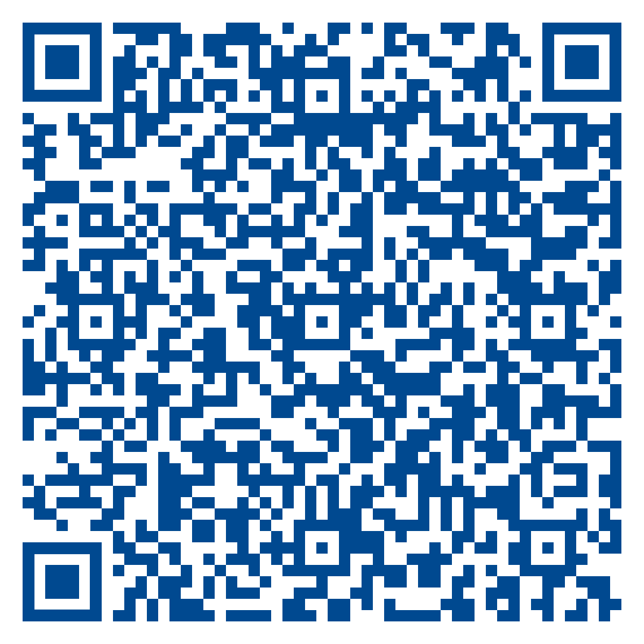
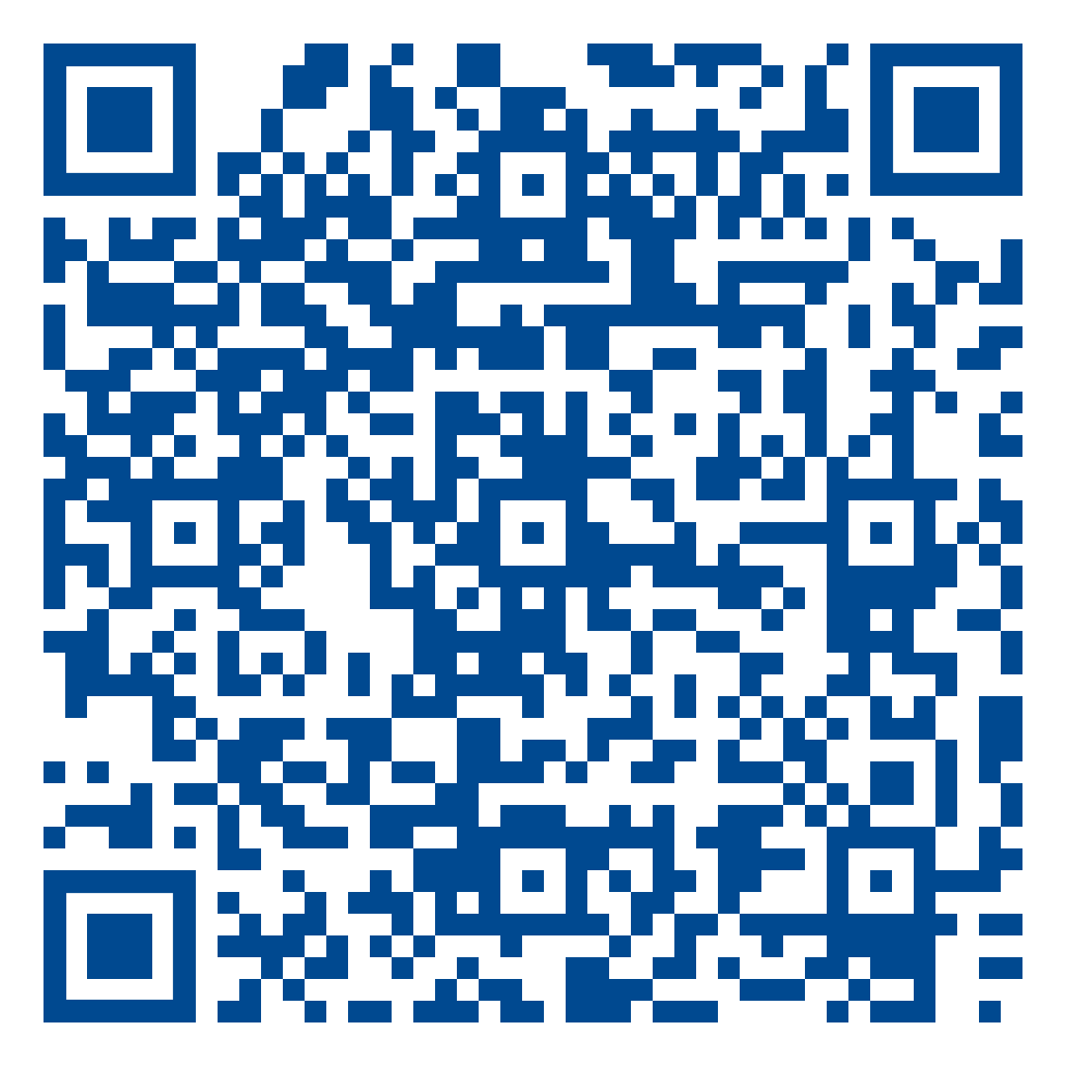
The QR code below can be used to access the page referenced in the previous slide.
December SYSCOM Training Summary
Start Date | Event
Mon, 05 Dec | Current Supervisor Training I (West)
Tue, 06 Dec | Pre-Retirement Training (East)
Strategic Thinking Competency Page
January Courses Open for Registration
Start Date | Event | Registration Deadline
Mon, 09 Jan | New Supervisor Workshop (East) | TBD
Tues, 17 Jan | Basic HR for Supervisors (East) | TBD
Mon, 23 Jan | Current Supervisor Training II (East) | TBD
Mon, 23 Jan | Basic HR for Supervisors (East) | TBD
Mon, 30 Jan | Basic HR for Supervisors (West) | TBD
Additional SYSCOM trainings for Jan will be added as dates are available. | Additional SYSCOM trainings are planned for Oct and Nov and will be added as dates are available.
Career Compass Event Calendar

